Slide 1


ACCESSIBILITY
Design and Develop for all

Slide 2
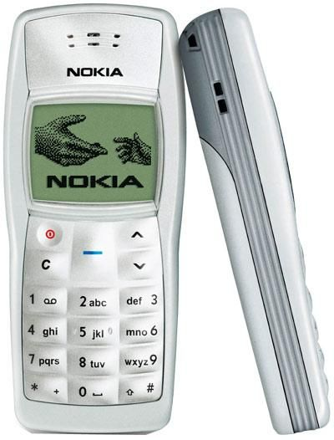
Evolution of Mobile phones
From this in 2003

Slide 3
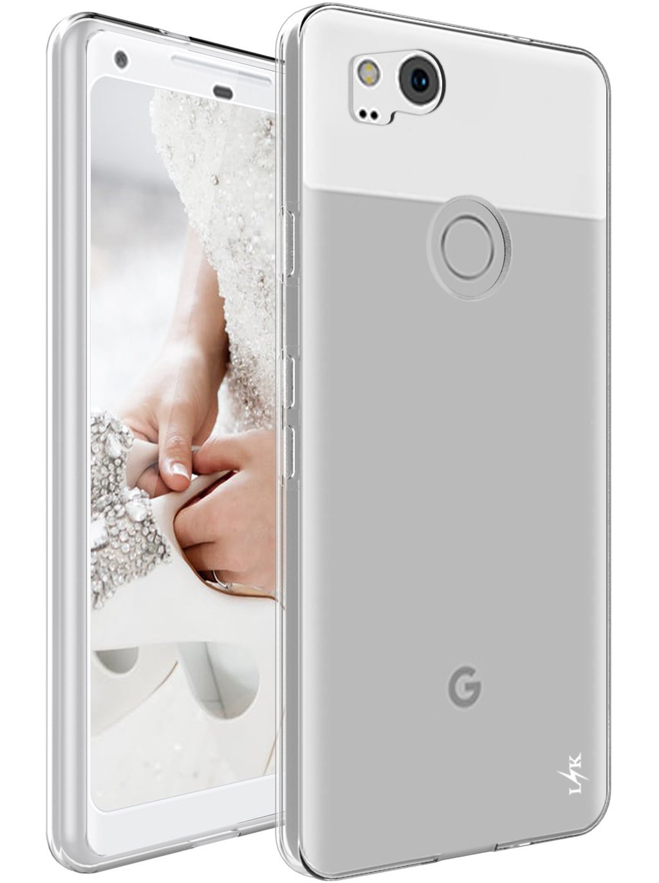
Evolution of Mobile phones
From this in 2003
To this 2017

Slide 4
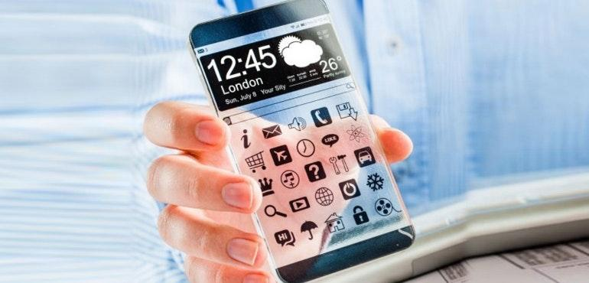
Evolution of Mobile phones
Somewhere in the future

Slide 5
Evolution of Mobile phones
Holographic Displays
Somewhere in the future

Slide 6
Evolution of Mobile phones
Holographic Displays
Flexible Frames
Somewhere in the future

Slide 7
Evolution of Mobile phones
Holographic Displays
Flexible Frames
Personal Assistant
Somewhere in the future

Slide 8
Evolution of Mobile phones
Holographic Displays
Flexible Frames
Personal Assistant
High end technology
Somewhere in the future

Slide 9
Evolution of Mobile phones
Holographic Displays
Flexible Frames
Personal Assistant
High end technology
Education
Somewhere in the future

Slide 10
Evolution of Mobile phones
Holographic Displays
Flexible Frames
Personal Assistant
High end technology
Education
Remote controls of our lives
Somewhere in the future

Slide 11
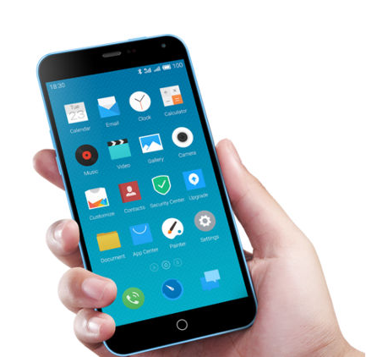
Smartphones today

Slide 12
Smartphones today
Playing
Shop
Transactions
Order food
Socializing
Transporting
Pictures

Slide 13
Smartphones today
Playing
Shop
Transactions
Order food
Socializing
Transporting
Pictures
Apart from calling and messaging

Slide 14
Smartphones today
Playing
Shop
Transactions
Order food
Is it equally usable by all?
Socializing
Transporting
Pictures
Apart from calling and messaging

Slide 15
Smartphones today
Playing
Shop
Transactions
Order food
Is it equally usable by all?
Is it ACCESSIBLE by all?
Socializing
Transporting
Pictures
Apart from calling and messaging

Slide 16

Smartphones today

Slide 17
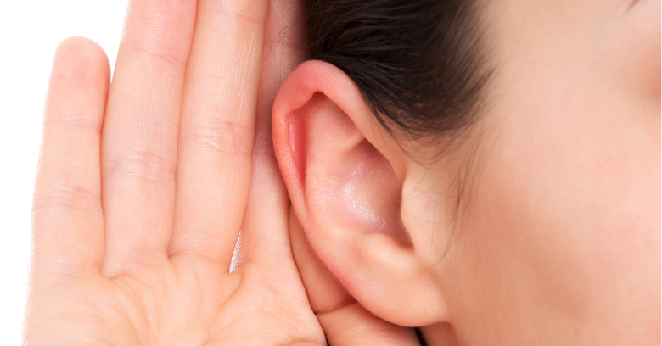



Smartphones today

Slide 18
Video!!

Slide 19
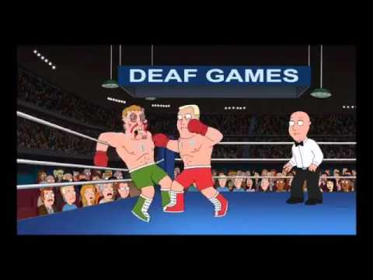
Video!!

Slide 20
Video!!
What do you think went wrong there?

Slide 21

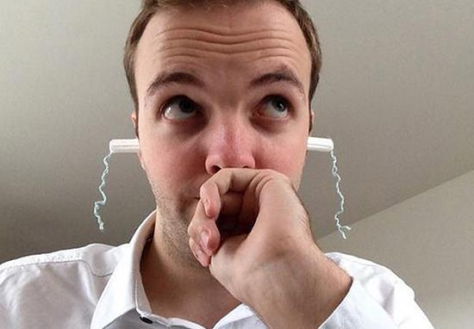
Interface Incompatible
Interface Incompatible!

Slide 22
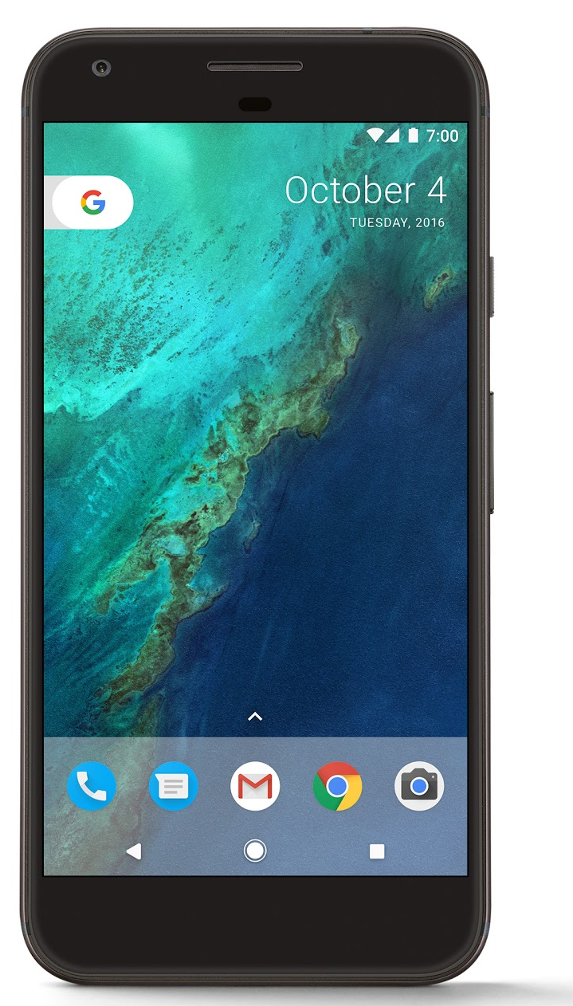

Interface Incompatible
Interface Incompatible??

Slide 23
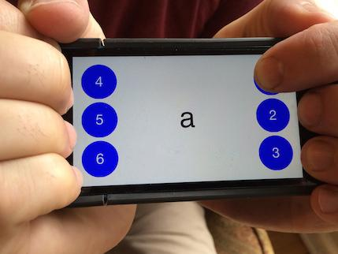
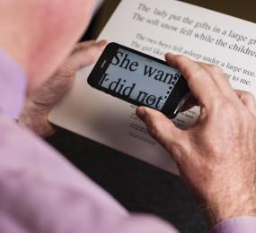
Assistive Technologies
Braille Touch
Magnifier

Slide 24
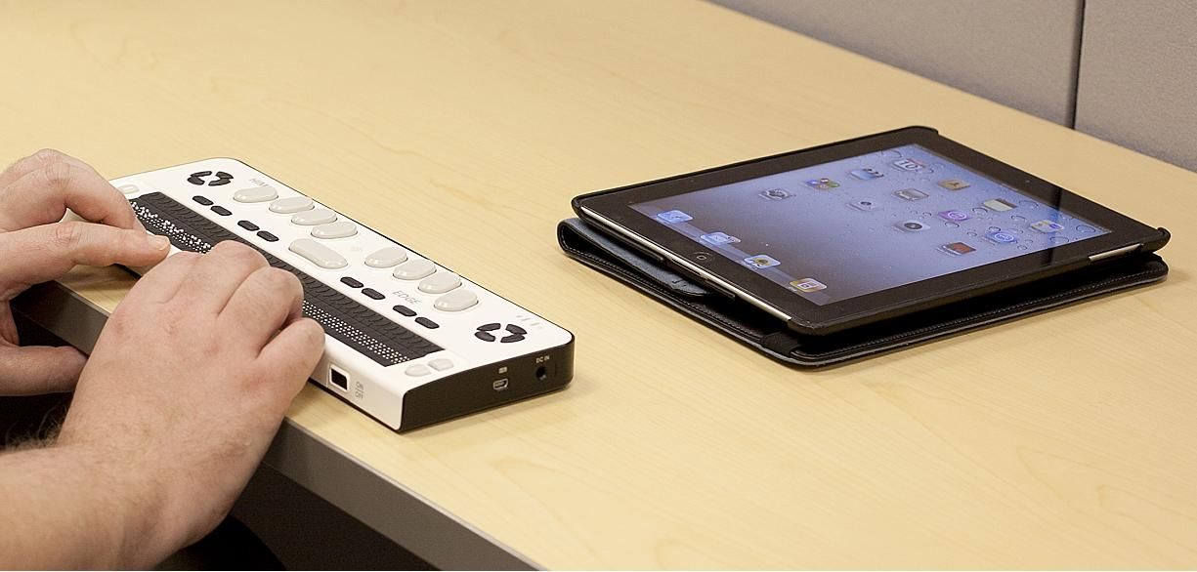
Assistive Technologies
Refreshable Braille Touch

Slide 25
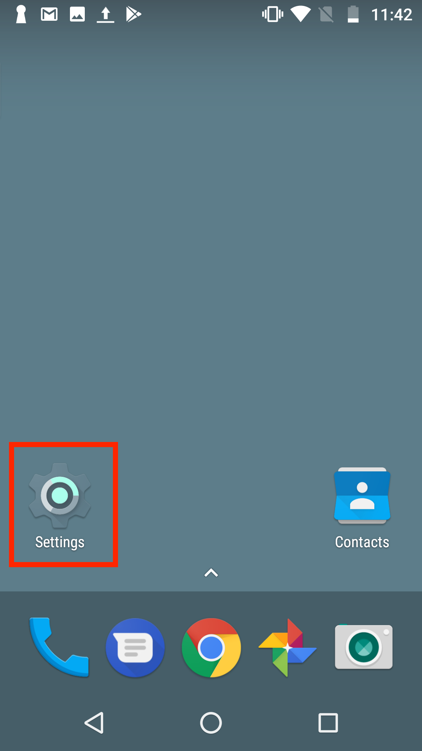
Assistive Technologies
Text to Speech

Slide 26
Assistive Technologies
Text to Speech (Voice over/Talkback)
Reads everything that is selected on the screen aloud

Slide 27
Assistive Technologies
Text to Speech (Voice over/Talkback)
Reads everything that is selected on the screen aloud
Sequential Navigation (Swipe to know, double tap to open)
Gestures
Audio cues

Slide 28
Talk Back/ Voice Over
Amazing!!! Right??

Slide 29
Talk Back/ Voice Over
Amazing!!! Right??
Well, let’s find out

Slide 30
Let’s Explore
Please turn on your accessibility

Slide 31
Let’s Explore
Please turn on your accessibility
Android
1, Go to settings
2. Scroll down to Accessibility
3. Toggle the TalkBack to on.

Slide 32
Let’s Explore
Please turn on your accessibility
Send ‘Hi’ to one of your friends using whatsapp (please don’t look at the phone :P )

Slide 33
Let’s Explore
Do you know how much time you took doing that?

Slide 34
Let’s Explore
Do you know how much time you took doing that?

Slide 35
Let’s Explore
Do you know how much time you took doing that?
120-140 seconds

Slide 36
Let’s Explore
Do you know how much time you took doing that?
120-140 seconds
Do you know how much time a user takes in doing the same task without talkback on?
Any guesses?

Slide 37
Let’s Explore
Do you know how much time you took doing that?
120-140 seconds
Do you know how much time a user takes in doing the same task without talkback on?
20-30 seconds
Notes:
The solution doesn’t seem to be so amazing now, does it?

Slide 38
Let’s Explore
Do you know how much time you took doing that?
120-140 seconds
Hmm. Why did that happen?
20-30 seconds

Slide 39
Let’s Explore
Hmm. Why did that happen?
120-140 seconds
Was the interface incompatible??
20-30 seconds

Slide 40
Let’s Explore
Hmm. Why did that happen?
Was the interface incompatible??
-Taken care of by talkback
120-140 seconds
20-30 seconds

Slide 41

Digging a Little Deeper
120-140 seconds
20-30 seconds

Slide 42
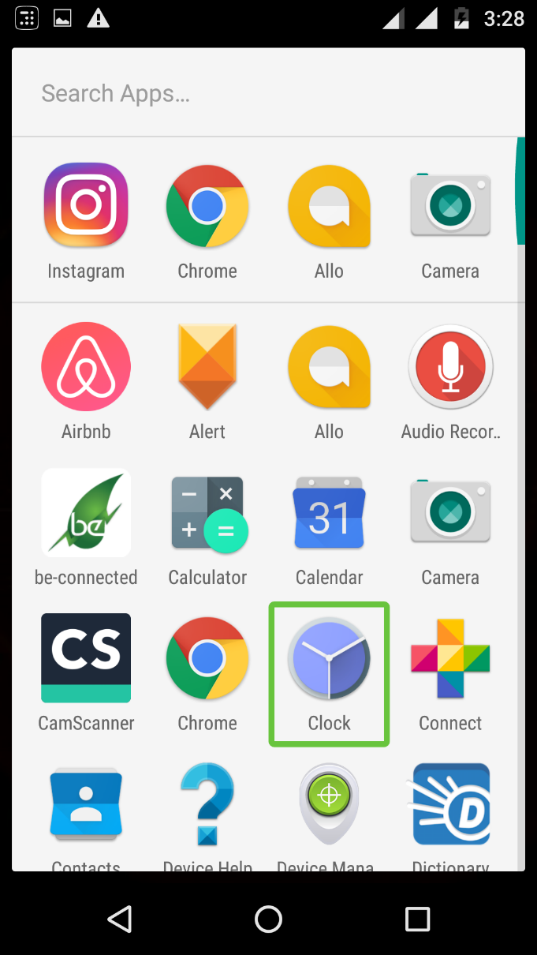
Identifying Problems
120-140 seconds
20-30 seconds
1. The user is constantly “Searching for” rather than “Looking for”
A left swipe will highlight chrome and the screen reader will read ‘Chrome (Pause) Double tap to open single tap and press for long press’
The User opts for Sequential Navigation rather than Direct Navigation

Slide 43

Identifying Problems
120-140 seconds
20-30 seconds
1. The user is constantly “Searching for” rather than “Looking for”

Slide 44



Identifying Problems
120-140 seconds
20-30 seconds
2. The user gets caught into a loop multiple times during one cycle of use
Swipe
Swipe
As the back, home and overview buttons lie on a different plane than the other elements. The chances of user getting caught in the loop of back to home to overview to back is quite high

Slide 45
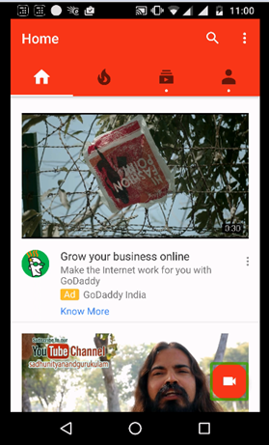
Identifying Problems
120-140 seconds
20-30 seconds
3. The Visual Hierarchy is not similar to the Talk-Back Hierarchy
The first swipe highlights the upload element. The audio feedback received is: “Upload Video” which does not receive the highest visual hierarchy

Slide 46
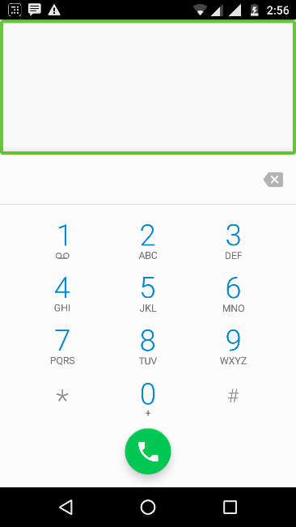
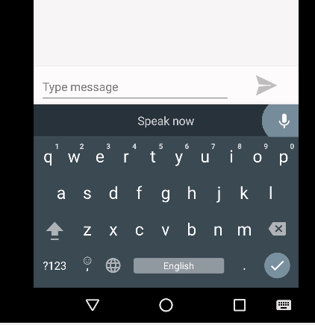
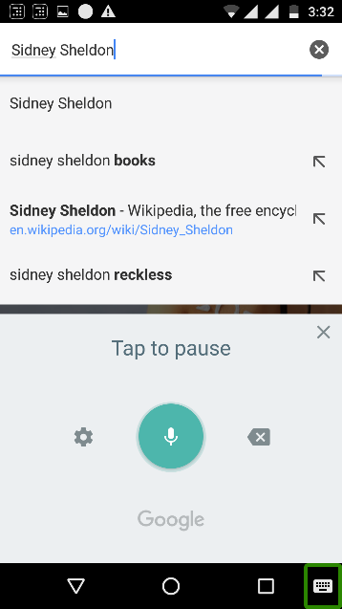

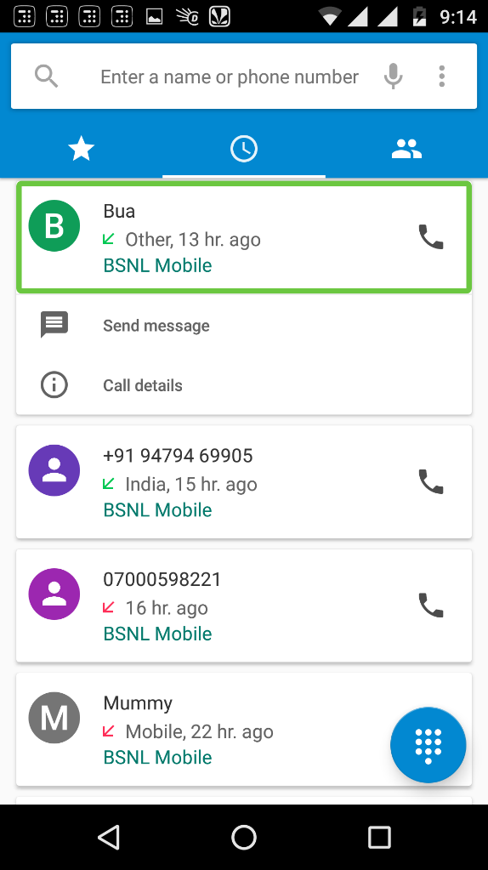
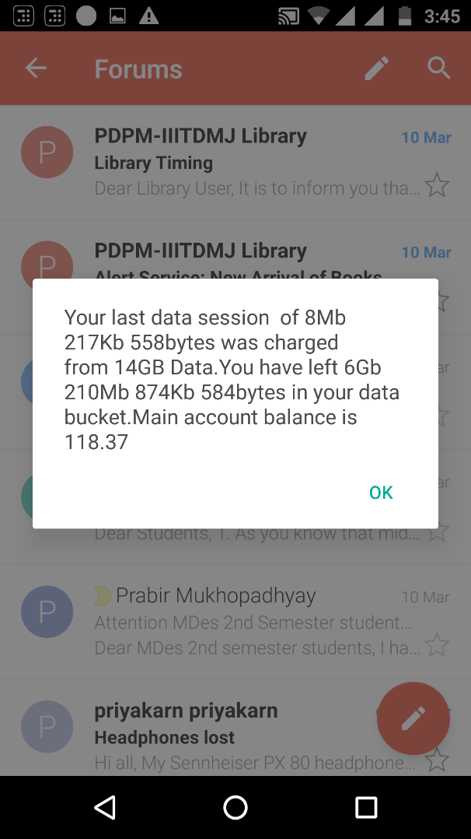
Identifying Problems
120-140 seconds
20-30 seconds
4. The icons are small and do not have a consistent layout
Different placements of same action items

Slide 47
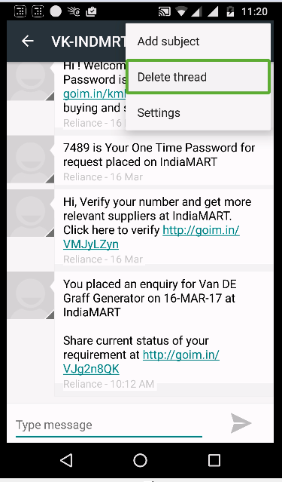
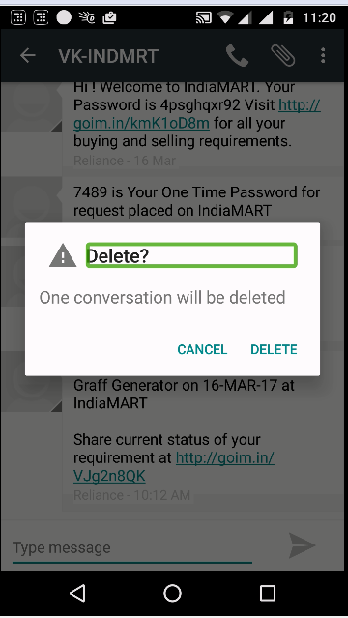
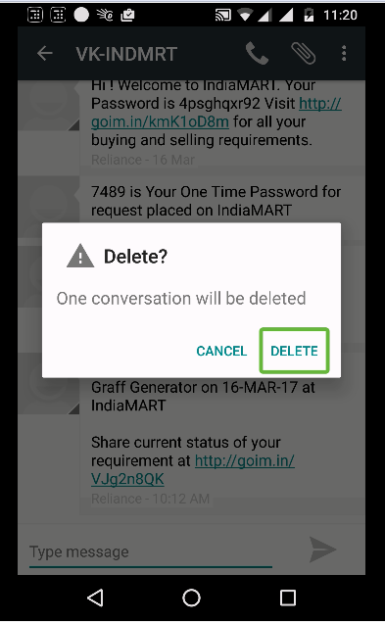
Identifying Problems
120-140 seconds
20-30 seconds
5. The actionable and non-actionable items are read in the same tone
The talk back reads a) Delete Thread. b) Delete. c) Delete in the same tone and pitch

Slide 48
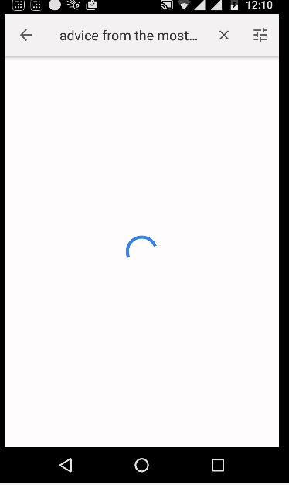
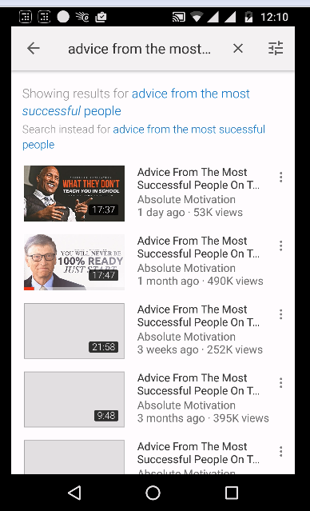
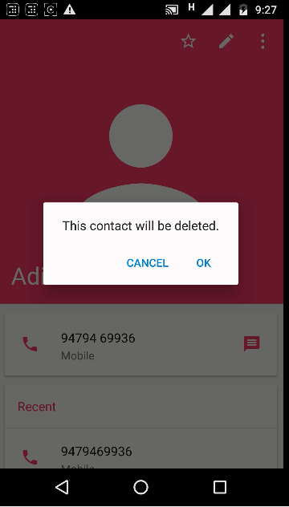
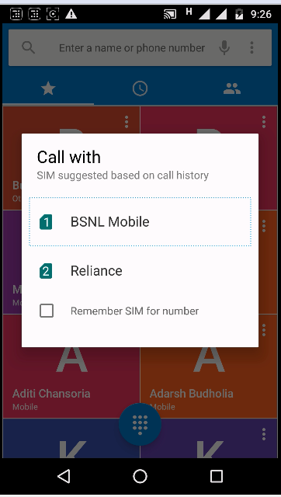
Identifying Problems
120-140 seconds
20-30 seconds
6. The user does not get the right feedback at the right time
There is no indication of pop-up when it appears on the screen. Also, as the pop up freezes the entire screen, the user remains clueless of why system has stopped functioning.
Visual feedback of arc moving around the circle but no audio feedback of search
When the search is complete a sound is heard which can easily be missed by the user

Slide 49
Identifying Problems
And many more...

Slide 50
Why??
The problem is not with accessibility, the problem is with the usability of that accessibility

Slide 51
Why??
The problem is not with accessibility, the problem is with the usability of that accessibility
We have an augmented solution that works only until a certain level.

Slide 52
Why??
W3C Guidelines : 25th February, 2015
The Current Logic
Design for Usability and Experience for users with no disability
Accessibility is added for disabled users

Slide 53
Why??
W3C Guidelines : 25th February, 2015
The Current Logic
Design for Usability and Experience
Accessibility
Users with no disability
Users with disability
Required Logic
Design for Usability and Experience
Design for accessible and make it usable
Users with no disability
Users with disability

Slide 54
How??
How do we do that??

Slide 55
How??
How do we do that??
Based upon the mental model of the user

Slide 56
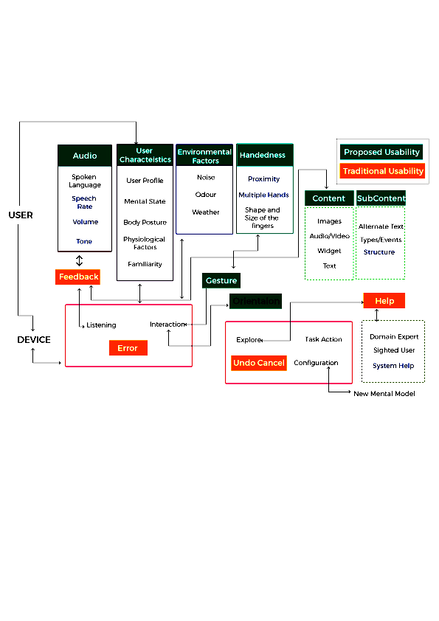
Mental Model of a Blind user??
Is based upon:
Relative position
Volume & Tone
Proximity
Multiple Hands
Structure
Orientation
System Help

Slide 57
Mental Model of a Blind user??
Insights from the Usability Study +
Mental Model of a visually Impaired user
Screen Layout + Proximity to Landmark
and Multiple hand
= First Design Direction
Visual Hierarchy + Structure = Second Design Direction
Feed-Back + Tone = Third Design Direction
Caught in loop + System Help = Fourth Design Direction

Slide 58
What??
Guidelines.
Problems were not related to just one single application
It can be used and reused and adapted on various other ICT devices

Slide 59
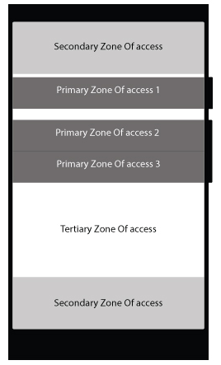
Guidelines
1. The layout of the interface must be designed based upon the tactile landmarks on the device

Slide 60
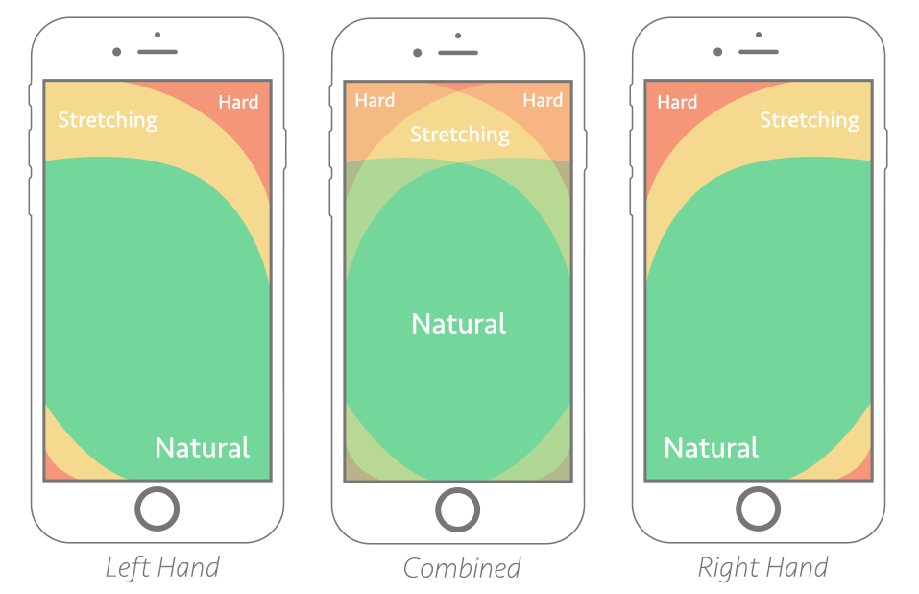
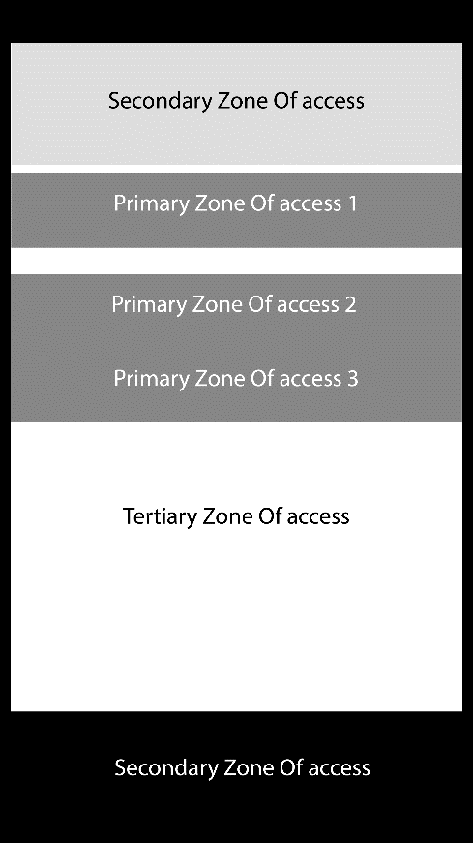
Guidelines
For sighted users using with single hand
For non-sighted users using with both hands

Slide 61
Guidelines
2. The talkback must disseminate information as it is disseminated visually
The First swipe should highlight the search option and should
be opened on the first double tap rather than the upload video option

Slide 62
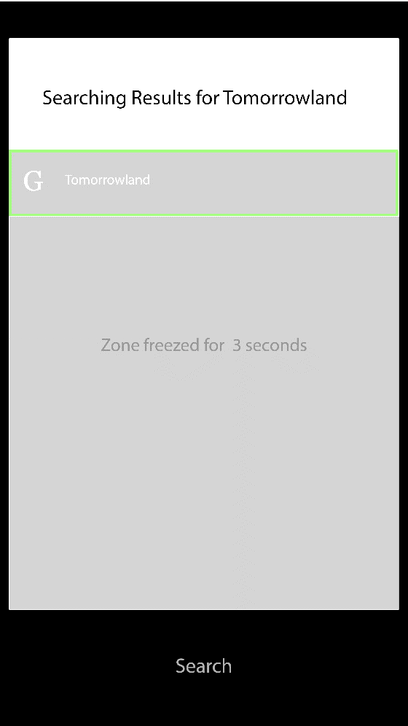
Guidelines
3. The user must always get the right audio feedback of the status of the actions performed (Third Design Direction)
When the device performs the action of searching, it will be intimated to the user and also appear on the secondary zone so that the user can take the finger there and know the listen to the status of what’s happening
A ‘Freeze the zone’ interaction can also be used to not let users make any mistake after getting anxious if the action takes a lot more time to get completed

Slide 63
Guidelines
4. System Must help the user from getting out of the loop if caught in one
(Forth Design Direction)
The system must push the user out of the loop if
the user is caught in it after the n number of
repeat

Slide 64
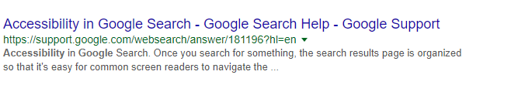
A few more..
Create labels for everything
Shouldn’t be read as “https colon forward slash forward slash support dot google dot com etc. But it should be read as: “Support Page under Google Accessibility”

Slide 65
A few more..
Avoid using place holders
Prefer this:
First Name

Slide 66
A few more..
Avoid using place holders
Prefer this:
First Name
Over this:
First Name

Slide 67

A few more..
Test the developed application manually as well as automatically to see whether every element is labelled properly and functions well.
Run it through accessibility scanners

Slide 68
Still continuing the work
Guidelines: Validating even further

Slide 69
Still continuing the work
Guidelines: Validating even further
Fixing Research methodology for accessibility

Slide 70
Individual Contribution
Usable accessible design.

Slide 71
Individual Contribution
Usable accessible design.
Design for larger range of personas

Slide 72
Individual Contribution
Usable accessible design.
Design for larger range of personas
Connect designs and develops to the guidelines, adhere them to Web Content Accessibility Guidelines

Slide 73
Individual Contribution
Usable accessible design.
Design for larger range of personas
Connect designs and develops to the guidelines, adhere them to Web Content Accessibility Guidelines
Conform designs to Accessibility Checklist

Slide 74
Individual Contribution
Usable accessible design.
Design for larger range of personas
Connect designs and develops to the guidelines, adhere them to Web Content Accessibility Guidelines
Conform designs to Accessibility Checklist
Keep evolving: Think what future holds and connect it with accessibility

Slide 75
It’s Incomplete if it's Inaccessible

Slide 76
It’s Incomplete if it's Inaccessible

Slide 77
Thank You!!
Connect with me over
LinkedIn / ADITI CHANSORIA
Facebook / ADITI CHANSORIA

